Slide 1
Brain Tumor Prediction Through MRI Images Using CNN In Keras
By Shivangi Pokhriyal

Slide 2
GUIDES ASSIGNED:
Dr. Upendra Raju
Ms. Suma N

Slide 3
OBJECTIVE
To build a classification model that would take MRI images of the patient and compute if there is a tumor in the brain or not.
Using dataset of Brain MRI Images for Brain Tumor Detection that is publicly available on Kaggle.
First build the model using simple custom layers of convolutional neural networks and then evaluate it.
At last, to compute some prediction by the model and compare the results.

Slide 4
SYNOPSIS
Tumor is an uncontrolled growth of tissues in any part of the body. Tumors are of different types and hence they have different treatments. Detection of tumor in the earlier stages makes the treatment possible. Here we review different segmentation methods associated with feature extraction from Magnetic Resonance Imaging (MRI) of brain. We also discuss different machine learning and classification algorithms that use to classify normal and cancerous tissues. Finally, we propose an automatic tumor detection system

Slide 5
The classification of brain tumors is performed by biopsy, which is not usually conducted before definitive brain surgery. The improvement of technology and machine learning can help radiologists in tumor diagnostics without invasive measures. A machine-learning algorithm that has achieved substantial results in image segmentation and classification is the convolution neural network (CNN). We present a new CNN architecture for brain tumor classification of three tumor types.
With good generalization capability and good execution speed, the new developed CNN architecture could be used as an effective decision-support tool for radiologists in medical diagnostics.

Slide 6
STEPS INVOLVED:
Development of CNN Algorithm
Collecting data
Data Preprocessing
Data Splitting – test set, train set, cross validation set
Data Augmentation
Training CNN
Testing the dataset
Result Inference

Slide 7
THE DATASET
The data set consists of two different folders that are Yes or No.
Both the folders contain different MRI images of the patients.
Yes folder has patients that have brain tumors whereas No folder has MRI images of patients with no brain tumor.
There are a total of 155 images of positive patients of brain tumor and 98 images of other patients having no brain tumor. All the images are of 240X240 pixels.

Slide 8
READ NEXT How NVIDIA Built A Supercomputer In 3 Weeks Computer vision techniques have shown tremendous results in some areas in the medical domain like surgery and therapy of different diseases. Even researchers are trying to experiment with the detection of different diseases like cancer in the lungs and kidneys. Different medical imaging datasets are publicly available today for researchers like Cancer Imaging Archive where we can get data access of large databases free of cost. A brain tumor is one of the problems wherein the brain of a patient’s different abnormal cells develops. They are called tumors that can again be divided into different types. Through this article, we will build a classification model that would take MRI images of the patient and compute if there is a tumor in the brain or not. We will be using Brain MRI Images for Brain Tumor Detection that is publicly available on Kaggle. We will first build the model using simple custom layers convolutional neural networks and then evaluate it. At last, we will compute some prediction by the model and compare the results. The Dataset The data set consists of two different folders that are Yes or No. Both the folders contain different MRI images of the patients. Yes folder has patients that have brain tumors whereas No folder has MRI images of patients with no brain tumor. There are a total of 155 images of positive patients of brain tumor and 98 images of other patients having no brain tumor. All the images are of 240X240 pixels. Brain Tumor Classification Model
Import the required libraries and dataset.
Download the dataset from Kaggle in google drive.
Read the images and store it in a separate list. Store all the images in X and all the corresponding labels into y.

Slide 9
OUTPUT
On checking few images it was found that the images were distorted because I resized them into 28X28 pixels.
Split the data into training and testing data.
convert the labels into categorical using Keras. utils and also transform them into NumPy arrays.
169 images of 28X28 pixels are in the training and 84 images of the same pixels in the testing sets.
Now build the network for classifying the MRI images. Define the network by adding different convents and pooling layers.

Slide 10
OUTPUT
After defining the network, compile the network using optimizer as adam and loss function as categorical cross_entropy. To measure the performance, metrics as accuracy is used.
After compiling the model, train the model for 50 epochs and check the results on the validation dataset.
After the training has completed for 50 epochs, evaluate the performance of the model on validation data.

Slide 11
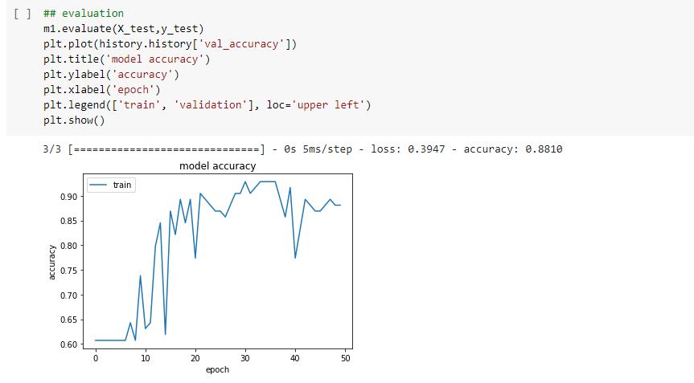

Slide 12
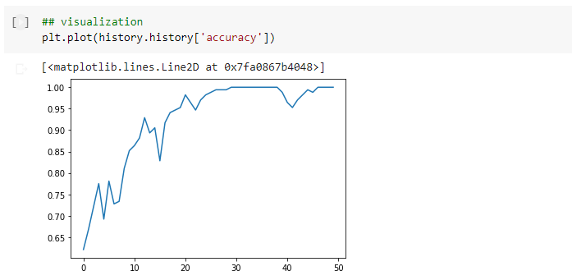

Slide 13
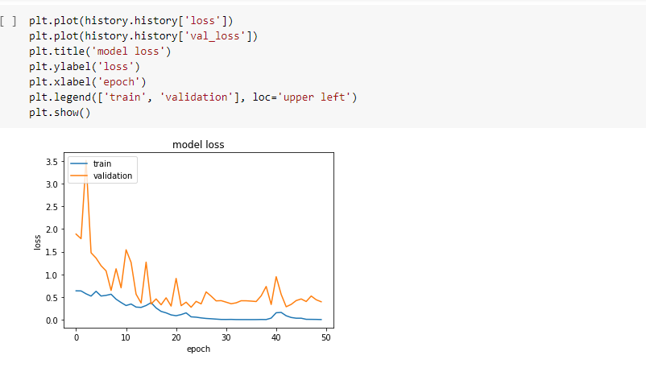

Slide 14
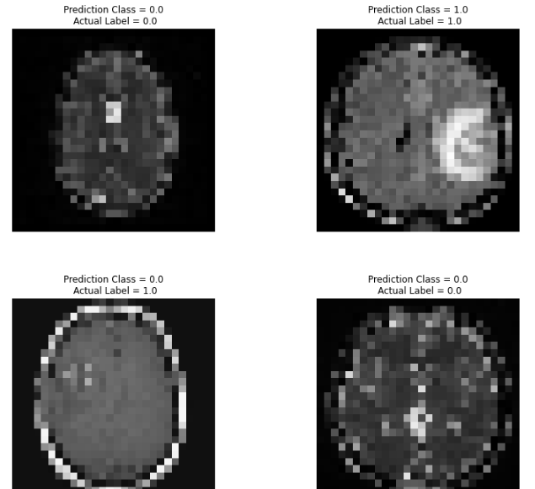
output

Slide 15
OUTPUT
Accuracy of 86% on the validation data with a loss of 0.592. Visualize the training and testing accuracy and loss with graphs.
Check some predictions made by the model whether they were correct or not.
The model computed 5 out of 6 predictions right and 1 image was misclassified by the model.
Evaluate the model performance using a classification report.

Slide 16
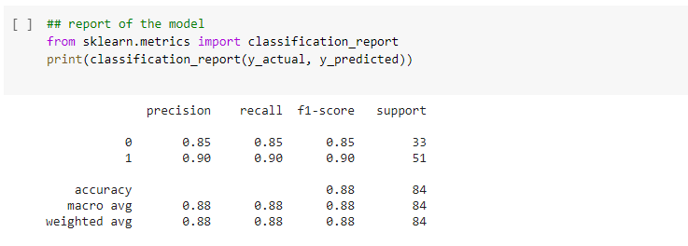
Classification Report

Slide 17
CONCLUSION
A classification model is successfully made with the help of custom CNN layers to classify whether the patient has a brain tumor or not through MRI images.
With a few no of training samples, the model gave 86% accuracy. If training data is increased by more MRI images of patients or perform data augmentation techniques, higher classification accuracy can be achieved.
Also, use of pre-trained architectures like Vgg16 or Resnet 34 maybe employed for improving the model performance.

Slide 18
REFERENCES
[1] https://analyticsindiamag.com/brain-tumor-prediction-through-mri-images-using-cnn-in-keras/, September 2020
[2] Milica M. Badža and Marko C. Barjaktarovi´c, “Classification of Brain Tumors from MRI Images Using a Convolutional Neural Network”, MDPI, Published, March 2020.
[3] https://github.com/MuhammadFathy/Study-of-Detection-Brain-Tumor-with-machine-learning
[4] Zheshu Jia, Deyun Chen “Brain Tumor Identification and Classification of MRI images using deep learning techniques”, IEEEAccess.

Slide 19
THANK YOU

